Slide 1

Shell and Tube Heat Exchanger and the variation in heat and other factors using Custom Baffles
Name | Gr no.
Siddhant Udgirkar | 21910623
Vishal Reghate | 21910702
Guide- Prof. Kore Sir

Slide 2
AGENDA
Introduction​
Primary goals
​Areas of growth
Timeline
​Summary​

Slide 3
Introduction
In the field of industries heat exchangers are used on large basis and there are certain types of advanced heat exchangers used for enhanced thermal performances and pressure drop. There are many attempts in this field to increase the performance of heat exchangers and the industry leading shell and tube heat exchanger. Shell and tube heat exchanger is used in almost all the largescale industries. This heat exchanger has several components which includes baffles, tubes, shells, measuring instruments and combining which we make the best suitable combination with given terms and conditions. We are focusing on shell and tube heat exchanger and the complex design of the baffles which is to be inserted in the shell at certain mass flow rate of hot and cold water. Our goal is to study and analysis the effects on the heat transfer rate and pressure drop.

Slide 4
PRIMARY GOALS
To increase the efficiency of the shell and tube heat exchanger by custom design of baffles. First we try the experiment on the apparatus constructed in Sinhagad Kondhwa by Prof. Wasekar Sir

Slide 5
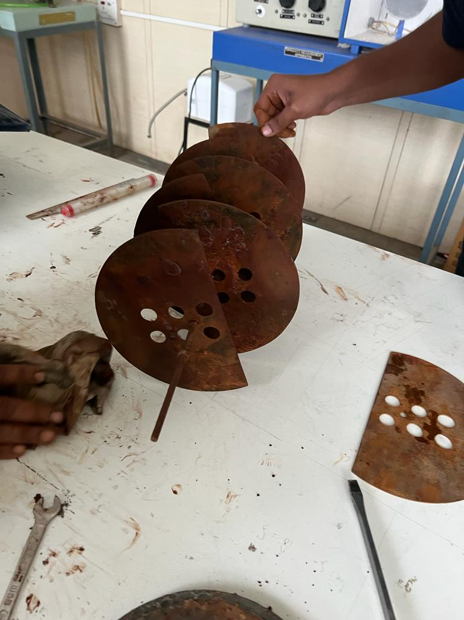
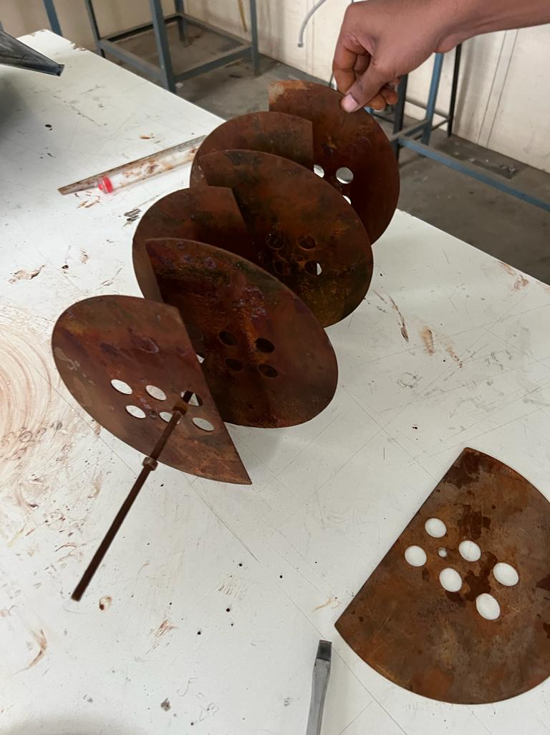
Current Variations-

Slide 6
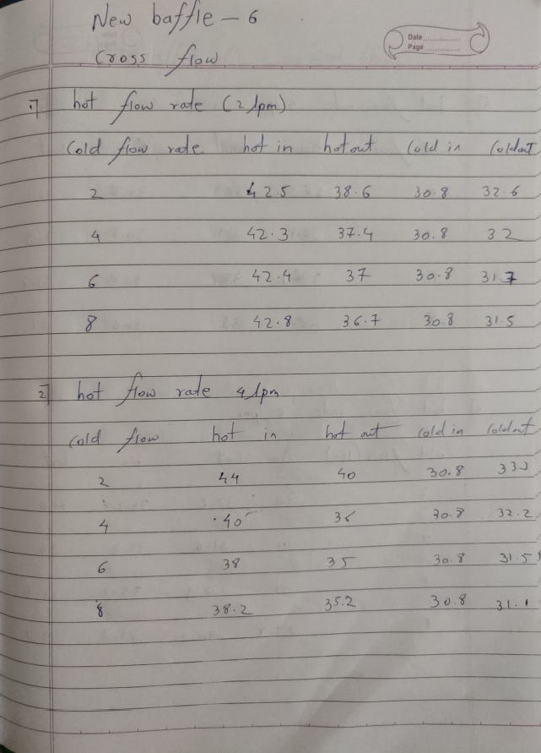
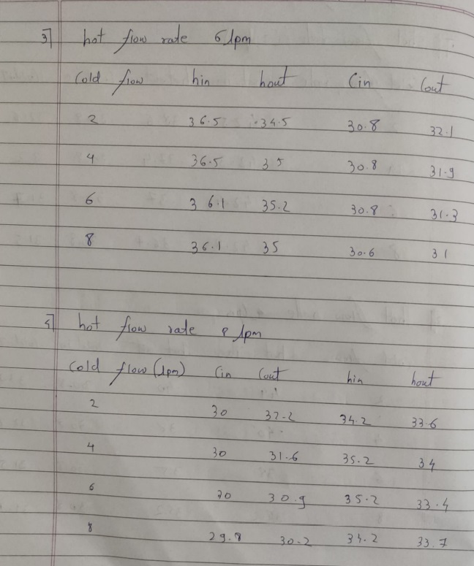
Readings-

Slide 7
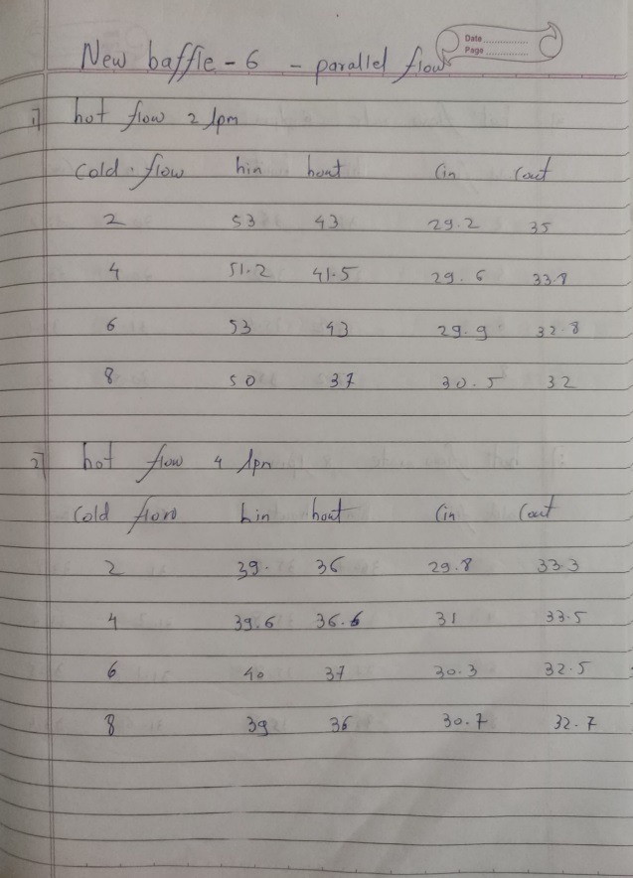
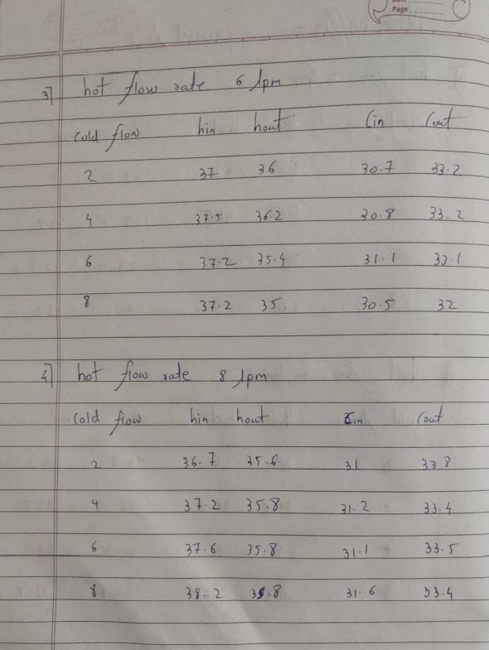

Slide 8
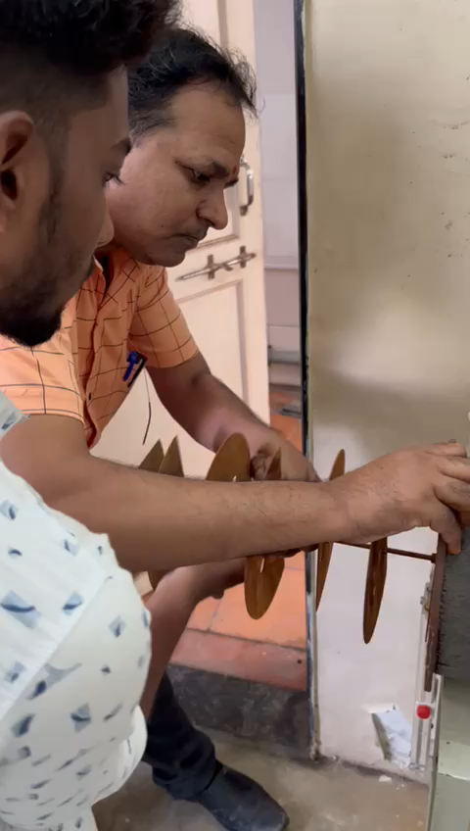
Areas of growth-
Inserting 8 Baffles
We need to have more precise and very well dimensioned tools and parts of the shell and tube heat exchanger. Because of the less ordered parts we need to face a lot of problems and hence need to face delay in the project.

Slide 9
TIMELINE
SEP 2022
Oct 2022
nov 2022
Finish the design of Baffles
Manufacture the desired design
Try all the possible readings

Slide 10
AREAS OF FOCUS
Appropriate Equipments
Time consumption
In order to get precise readings we need good quality of measuring devices like pressure meter, flow meter.
The flow should always be constant which is a real life difficulty because of water level in the college water tank.
The temperature of the inlet cold water also varies day to day and hence results in some error.
All the iteration performed takes a lot of patience and focus. Per reading we need at least 25-30min of constant observation.
This is a very time consuming process and to maintain the precision we need to have patience.

Slide 11



HOW WE GET THERE
Mini targets
Modifications
Check the outcome
Try the practical solution out on available baffles.
Get enough theoretical knowledge.
Try the same practical result using different type of custom baffles.
Check if the results we get is more efficient that that of the earlier type of baffle.

Slide 12
SUMMARY
In this project, we believe that under proper guidance this project can make a big impact, and we wish that happen. By using the data, we help industries the best way possible by improving the efficiency.

Slide 13
THANK YOU
Name | Gr no.
Siddhant Udgirkar | 21910623
Vishal Reghate | 21910702

